Slide 1

Title of Final Year Project Thesis Presentation.
Presentation on
Presented By
Supervised By
Your Name
Program: B.Sc. in CSE (HSC/Diploma)
ID: 0XXXXXXXXXXX
Batch: 0th
Semester: 0th
Session: Spring/Summer - 2025
Supervisor Name
Lecturer/ Assistant Professor
Dept. of CSE, PUB
Department of Computer Science & Engineering
Pundra University of Science & Technology, Bogura – 5800

Slide 2
Title of Final Year Project Thesis Presentation.
Presentation on
Presenter:
Your Name
ID: 00XXXXXXXXXX
Your Name
ID: 00XXXXXXXXXX
(Only for group Presentation)
Department of Computer Science & Engineering
Pundra University of Science & Technology, Bogura – 5800

Slide 3
Title of Final Year Project Thesis Presentation.
Presentation on
Presented By
Supervised By
Your Name
Program: B.Sc. in CSE (HSC/Diploma)
ID: 0XXXXXXXXXXX
Batch: 0th
Semester: 0th
Session: Spring/Summer - 2025
(Group details)
Your Name
Program: B.Sc. in CSE (HSC/Diploma)
ID: 0XXXXXXXXXXX
Batch: 0th
Semester: 0th
Session: Spring/Summer - 2025
Supervisor Name
Lecturer/ Assistant Professor
Dept. of CSE, PUB

Slide 4
Outline
Introduction
Objectives
Literature Review/ Related Work
Problem Statement
Dataset
System Overview
Methodology / Implementation
Result Analysis
Beneficiaries/ Application
Conclusion
Future Work
References
(Feel free to add, remove, rearrange or merge sections as needed based on the nature and scope of your project/ thesis)

Slide 5

Introduction
Use Times New Roman as the font throughout your thesis presentation. Set slide titles in a larger size (28–36) to make them stand out. For body text, use a clear and readable size (18–20). Add captions below figures and tables in a smaller size (12–14), and keep footnotes at the bottom in size 12. Following these simple rules will keep your slides professional, consistent, and easy to read.
Align all body text as justify to create a clean and balanced look across slides. Keep slide content concise by using short bullet points, avoid overcrowding, and ensure consistent formatting and layout throughout the presentation. Including slide numbers, clear section headings, and high-quality visuals can further enhance clarity and audience engagement.
Figure 1: Computer Science & Engineering

Slide 6
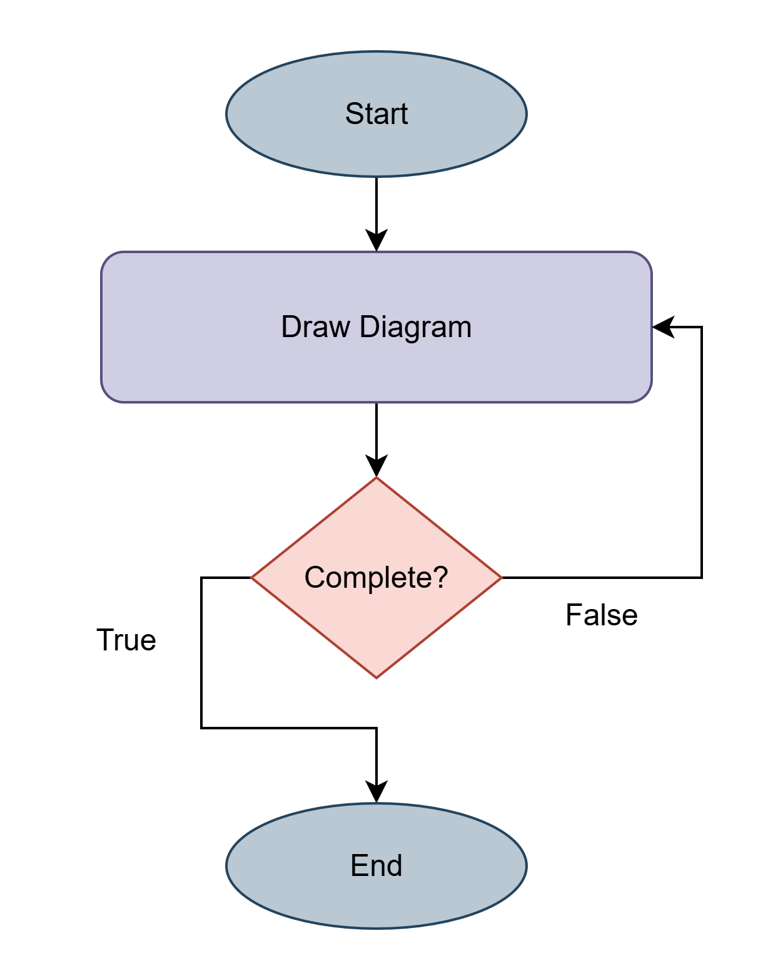
Introduction (contd..)
When inserting an image or figure into your presentation slide, always place it in a central or balanced position to maintain a clean layout. Add a clear, descriptive caption below the image using the format:
Figure #No: Figure name
The caption should be written in Times New Roman with a font size of 12–14 to differentiate it from the main body text. Ensure the image is high resolution and appropriately sized so it is easily visible to the audience without overwhelming the slide.
Create diagrams using tools like draw.io, Lucidchart, or similar, to ensure they look clean and professional. Make sure each diagram directly supports your content and is easy for the audience to read.
Figure 2: Diagram Name

Slide 7
Objectives
Start each objective with “To…”
Make each point specific, measurable, and focused on action
Cover what your project aims to build, improve, or analyze
Keep each point clear and concise (1–2 lines)
For example: To develop a deep learning-based system capable of detecting and recognizing Bengali license plates from vehicle images.

Slide 8
Literature Review (1/1)
Title: Hasan et. al [1] - A Three Stage Framework for Detection and Recognition of Bangla License Plate.
Contribution:
  Developed a license plate detection and recognition system for the Bengali language
  Introduced a string-matching system to enhance recognition accuracy
  Achieved ~99% accuracy under controlled conditions
Limitation:
  Does not perform reliably in diverse weather conditions (e.g., rain, fog, low light)

Slide 9
Problem Statement
Clearly explain what the problem is.
Explain why it matters (practical, technical, or societal importance)
Describe who is affected (users, community, system)
Keep it specific, concise, and focused (usually 3–5 sentences)
Avoid proposing solutions here — just define the problem
For example: Despite recent advancements in license plate recognition systems, accurate detection and recognition of Bengali license plates remain challenging. Existing methods often rely on controlled conditions and struggle under diverse weather situations, such as rain, fog, and low light. This limits their practical use in real-world traffic monitoring and law enforcement in Bangladesh. Therefore, there is a need for a robust and accurate system specifically designed for the complexities of Bengali license plates in uncontrolled environments.

Slide 10
Dataset
Mention the name and source of the dataset
State the size and number of classes/samples
Describe the type of data and format (e.g., images, text, CSV)
Explain why this dataset is relevant to your project
Briefly note any preprocessing or augmentation applied
Mention limitations or challenges (e.g., imbalance, noise, resolution)

Slide 11
Methodology
Clearly describe your approach or process step by step
Mention the algorithms, models, tools, or frameworks used
Explain how you prepared and processed the data
Include diagrams (e.g., workflow, system architecture) to illustrate the process
Explain why you chose these methods or tools
Keep it concise, logical, and focused on how you solved the problem

Slide 12
Result Analysis
Table 1: Table Caption
Column 1 | Column 2 | Column 3 | Column 4
Row #1
Row #2
Row #3
Row #4
Row #5

Slide 13
Result Analysis (contd..)
Present key findings clearly, using tables, graphs, or charts
Include comparative results with other methods, models, or benchmarks
Use screenshots or sample outputs to visually demonstrate your system or model performance
Explain what the results mean, highlighting strengths and weaknesses
Keep it organized and focused on how the results support your objectives and problem statement

Slide 14
Beneficiaries
Identify who benefits directly
Explain how your project or system helps them
Mention real-world applications or scenarios where it can be used

Slide 15
Conclusion
Briefly restate what you did and what was achieved. Summarize key results and highlight how they address the problem. End with a remark on the significance of your work.

Slide 16
Future Work
Suggest practical improvements or new features. Mention limitations to overcome, and explain how these extensions could make the project more useful or robust.

Slide 17
References
When adding references to your slides, use Times New Roman and keep the font size slightly smaller than your main text (usually 16–18) to fit multiple entries neatly. Follow the APA format, which typically includes: Author’s surname, initials. (Year). Title of the work in italics. Publisher or source. For example:
Hasan, N., Islam, M. A., Nayeem, M. J., Rana, S., & Islam, M. R. A Three-Stage Framework for Automatic Bengali License Plate Detection and Recognition System. Available at SSRN 4648216.
Goodfellow, I., Bengio, Y., & Courville, A. (2016). Deep learning. MIT Press.
World Health Organization. (2023, March 15). Artificial intelligence in health: Guiding principles. https://www.who.int/publications/ai-in-health-guiding-principles

Slide 18
Thank You.
Any Questions?

